Slide 1

ΚΒΑΝΤΙΚΗ ΠΛΗΡΟΦΟΡΙΑ ΚΑΙ ΕΠΕΞΕΡΓΑΣΙΑ
Bantis peter
MSc in Computational physics
25/6/2022

Slide 2

Theoretical background
Hydrostatic equation: $\frac{d}{dr}\left[\frac{r^{2}}{ρ(r)}\frac{dp(r)}{dr}\right]=−4πGr^{2}ρ(r)$
General polytropic equation of state: $p=Kρ^{γ}$
The solution of the above equation is achieved for the following initial conditions: $\left\{\begin{aligned}ρ\left(0\right)=ρ_{0} \\ ρ^{′}\left(0\right)=0\end{aligned}\right.$
With a new variable $ρ\left(r\right)=ρ_{0}{θ(ξ)}^{1/(γ−1)}$ and ξ=r/a
with $a^{2}=\frac{Kγ}{4πG(γ−1)}ρ_{0}^{(γ−2)}$
So, the first equations become the Lane-Emden equation with boundary conditions $θ\left(0\right)=1$ and $θ^{′}\left(0\right)=0$
$$\frac{1}{ξ^{2}}\frac{d}{dξ}ξ^{2}\frac{dθ}{dξ}+θ^{1/(γ−1)}=0$$

Slide 3

Where $ρ\left(R\right)=0→θ\left(ξ_{R}\right)=0$ with $ξ_{R}≡R/a$
The k-integration is in the interval $k∈[k_{min}=\frac{π}{R},∞)$
$M=4π\int_{0}^{R}{ρ(r)r^{2}dr}=4πρ_{0}α^{3}\int_{0}^{ξ_{R}}{θ^{\frac{1}{γ−1}}(ξ)ξ^{2}dξ}∝ρ_{0}α^{3}∝ρ_{0}^{(3γ−4)/2}$
Using dimensionless variables in the Fourier transform of the energy density, the modal fraction becomes:
$\tilde{f}\left(k\right)=\frac{h(ak)}{h(\frac{απ}{R})}=\frac{h(ak)}{h(\frac{π}{ξ_{R}})}=\frac{h(ak)}{C(γ)}$ , $\tilde{f}\left(κ\right)=\frac{h(k)}{h(κ_{min})}$
Where C(γ) independent of $ρ_{0}$, and $h(ak)$ is
$h\left(ak\right)={|\int_{0}^{ξ_{R}}{θ^{\frac{1}{γ−1}}\left(ξ\right)e^{iak∗ξ}ξ^{2}dξ}|}^{2}, h\left(κ\right)={\frac{4πρ_{0}α^{3}}{κ_{min}}\int_{0}^{ξ_{R}}{θ^{\frac{1}{γ−1}}\left(ξ\right)\sin\left(κ_{min}ξ\right)ξdξ}}^{2}$
The configurational entropy is then
$$S=−4π\int_{k_{min}}^{∞}{\frac{h\left(ak\right)}{C\left(γ\right)}\log\left(\frac{h\left(ak\right)}{C\left(γ\right)}\right)}k^{2}dk=−4πa^{−3}\int_{k_{min}}^{∞}{\frac{h\left(k\right)}{C\left(γ\right)}\log\left(\frac{h\left(k\right)}{C\left(γ\right)}\right)}κ^{2}dκ=−4πa^{−3}\int_{k_{min}}^{∞}{\tilde{f}\left(κ\right)\log\left(\tilde{f}\left(κ\right)\right)}κ^{2}dκ$$
where $κ=ak$, so $κ_{min}=π/ξ_{R}$ , $ξ_{R}=R/α$ with $Sρ_{0}^{−1}∝α^{−3}ρ_{0}^{−1}∝ρ_{0}^{(4−3γ)/2}$.

Slide 4
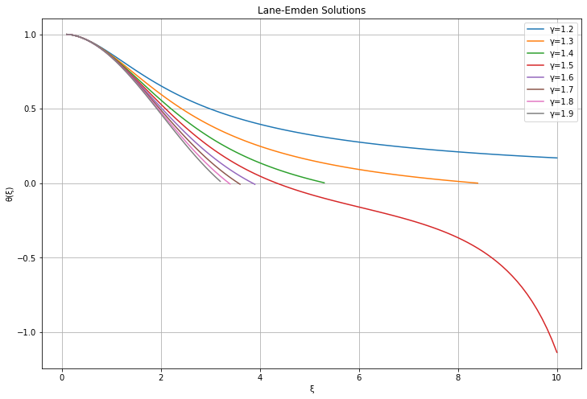
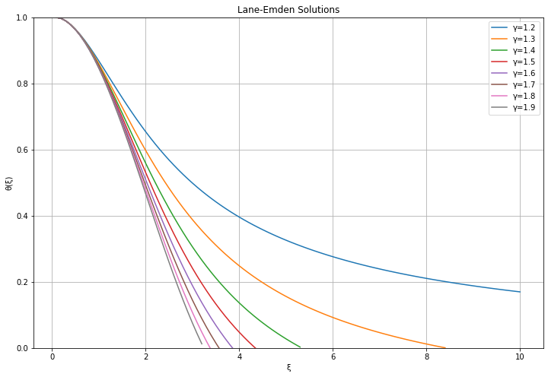
1st CODE AND FIGURES
Line 1- Line 7 : libraries used
Line 11 – Line 179 : Uses RK4 to solve RK4 with γ=1.2 - 1.9

Slide 5

Line 183 – Line 266: by dividing the Lane Emden equation to 2 different differential equations we can solve the system $\left\{\begin{aligned}\frac{dθ}{dξ}=−\frac{φ}{ξ^{2}} \\ \frac{dφ}{dξ}=θ^{1/(γ−1)}ξ^{2}\end{aligned}\right.$ for different gammas.
We are using we use “odeint” from scipy to solve the system
Then we get rid of the NaN values from the arithmetic approach.
We procced to interpolate the Lane Emden with “interp1d” from scipy and then calculate the $\tilde{f}\left(|k|\right)$.
Finally, we plot the $\tilde{f}\left(|k|\right) −k/\sqrt{4πG/K}$ for different $γ$.

Slide 6

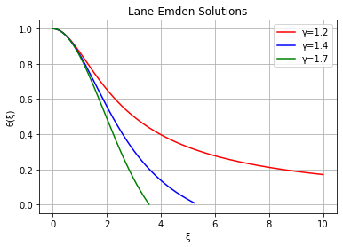



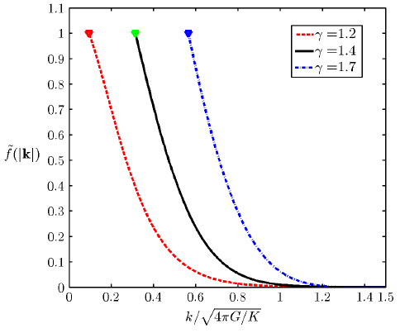
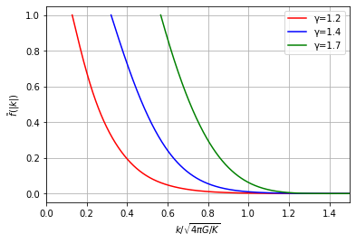


Slide 7
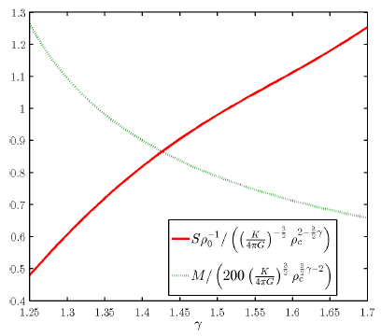
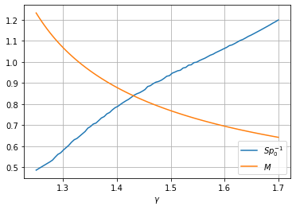

2nd CODE AND FIGURES
Line 1- Line 7 : libraries used
Line 10 - 75 : Again, we use “odeint” to solve the Lane Emden and then we proceed to Mass (M) and Configurational Entropy (S) for different $γ$. Interpolation is used to calculate $\tilde{f}\left(|k|\right)$ and “quad” from Scipy is used to arithmetically calculate the integrals.

Slide 8
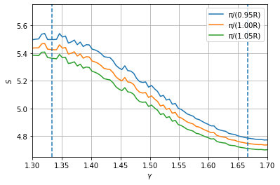
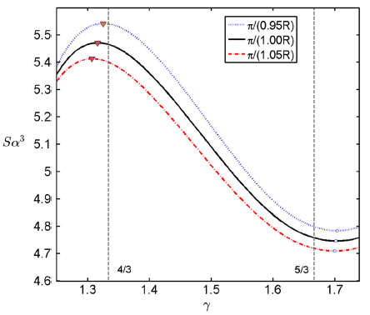
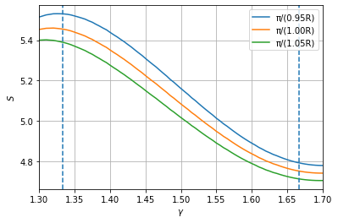

3rd & 4th CODE AND FIGURES
The polytropic entropy for every $γ$ was calculated using 2 ways.
The main difference between the two was that the 1st used “odeint” to calculate the solution of the Lane-Emden equation, in contrast to the 2nd one that used “solve_ivp” from Scipy module.
The first one appear to have fluctuation that are being lowered signific ally when the $γ$ rises. The second one appears to be smooth, without any fluctuations and closer to the diagram of the paper.

Slide 9
THANK YOU FOR YOUR TIME!

